Slide 1
None of us is as smart as all of us.
– Ken Blanchard
Lecture 18 – Introduction to Decrease-and-Conquer
CST370 – Design & Analysis of Algorithms
Dr. Byun
Computer Science

Slide 2
Lecture Objectives
After completion of this lecture, you will be able to
  understand the basic idea of decrease-and-conquer techniques.
  explain the basic operation of insertion sort.

Slide 3
Introduction to Decrease-and-Conquer
Watch this video first
  https://youtu.be/EoxGtMn6Ixk
Basic Idea
  Reduce a problem’s instance to a smaller instance of the same problem.
  Solve the smaller instance
  Extend the solution of the smaller instance to obtain the solution to the original instance.

Slide 4
Decrease-and-Conquer: Three Variations
Decrease by a constant
  Generally, we reduce a problem’s size by one.
Decrease by a constant factor
  We typically reduce a problem’s size by half (= 50%).
Variable size decrease
  The size of a problem we are reducing varies.

Slide 5
Chapter 4: Decrease-and-Conquer
4.1 Insertion Sort
4.2 Topological Sorting
4.3 Algorithms for Generating Combinatorial Objects
4.4 Decrease-by-a-Constant-Factor Algorithms
4.5 Variable-Size-Decrease Algorithms

Slide 6
Insertion Sort – Basic Idea
To sort an array A[0..n-1], sort A[0..n-2] first.
  Then, insert the last element A[n-1] to its proper place in the sorted array A[0..n-2].
Usually we implement it bottom up.

Slide 7
Example

Slide 8
Exercise

Slide 9
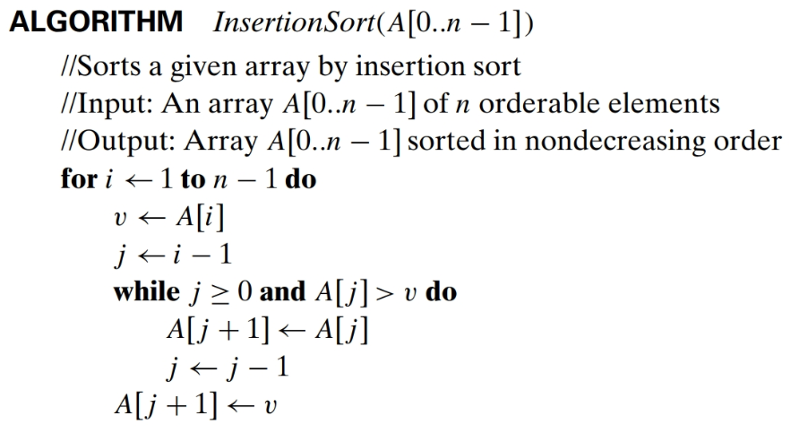
Algorithm

Slide 10
Time Efficiency (1 of 2)

Slide 11
Time Efficiency (2 of 2)

Slide 12
Additional Resource
If you need an additional resource for the insertion sort, watch this video.
  http://y2u.be/i-SKeOcBwko

Slide 13
Puzzle: Find a Famous Actor (1 of 2)
Let's say that we have n gentlemen in a room.
  One of the gentlemen is a famous actor and all others are the general public.
  Suppose all the public in the room know the famous actor.
  But the actor doesn’t know all the other people in the room.
  We assume that some of the public may know or may not know the other public in the room.

Slide 14
Puzzle: Find a Famous Actor (2 of 2)
Now, you will go to the room and find the famous actor among the n gentlemen.
  In this scenario, we assume that you don’t know anyone in the room, including the famous actor.
  The only action you can do is to pick two (random) gentlemen and then ask to the first person “Do you know this person (= second person)?”
  The only answer from the interviewee should be "yes" or "no".
  You have to find the famous actor based on the answers. How many times do you have to ask this question to find the famous actor?

Slide 15
Hint
n is a general number, and you may think that it’s too big.
Instead, can you reduce n to a small, reasonable number?
How about 1?
  Of course, a gentleman in the room means that he is the famous actor.
How about 2 and then 3?

Slide 16
Solution

